Slide 1
Complex Function Contours
By Christina Mooshil

Slide 2
Complex Numbers
Set Notation: C = {a + bi | a,b in R, i = √-1 }
The set of complex numbers are of the form a + bi where a and b are real numbers and i is the square root of -1
Complex numbers have a “real part”, a, and an “imaginary part”, bi.
We will denote complex numbers as z = x + iy

Slide 3
Some Complex Analysis
Modulus: |z| = |x + iy| = √ (x² + y²)
Argument: arg(z) = { θ+ 2πn | n is an integer }
Principle Argument: Arg(z) = θ = arctan(y/x)
Logarithmic Function: log(z) = { ln(|z|) + i(Arg(z) + 2πn | n is an integer }
Principle Logarithm: Log(z) = ln(|z|) + i(Arg(z))
Notes:
The definitions of Arg(z) and Log(z) above, and in my program, are the principle values of these functions. Complex numbers have infinitely many logarithms and arguments.

Slide 4
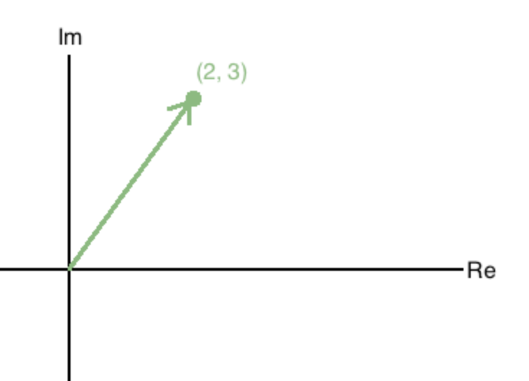
Graphing Complex Numbers
The complex plane must be represented as the imaginary part (y-axis) and the real part (x-axis) of an imaginary number.
Here we have a plot for z = 2 + 3i , which can be denoted as the ordered pair (2, 3).

Slide 5
Graphing Complex Functions
Complex functions cannot be graphed by hand using Cartesian coordinates because they are in four dimensions.
Mathematicians use a variety of ways to visualize complex functions, including plotting them in three dimensions and as contours.
Just as we plotted the Mandelbrot fractal and Julia sets, we will plot some complex functions in Spyder using matplotlib.

Slide 6
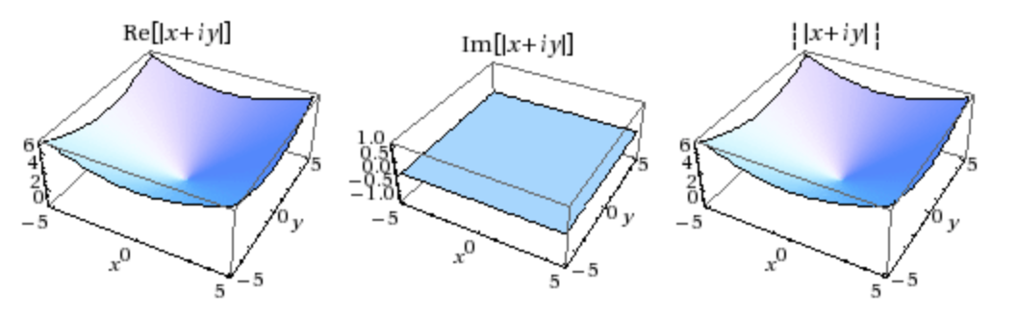
Interpreting Contours: Modulus

Slide 7
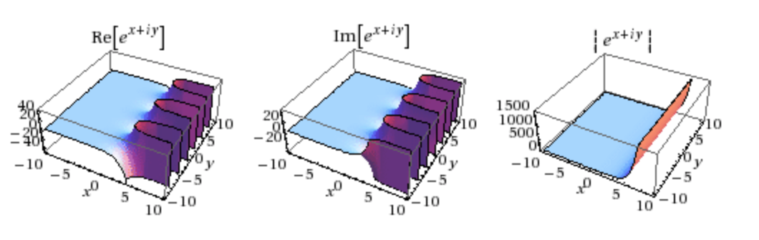
Interpreting Contours: Exponential Function

Slide 8
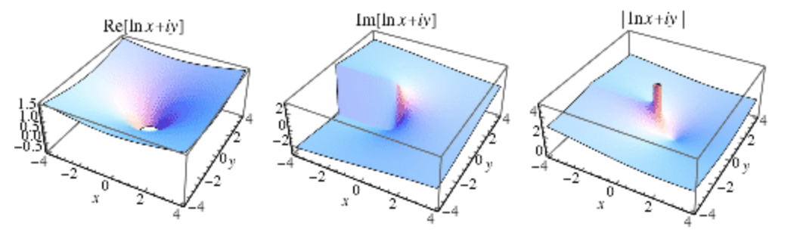
Interpreting Contours: Logarithmic Function

Slide 9
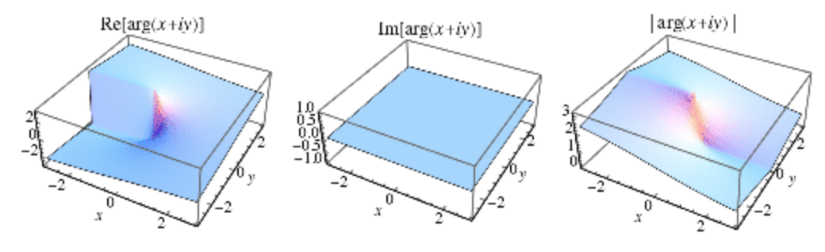
Interpreting Contours: Complex Argument

Slide 10
Programming Difficulties
Class for each math function used
Any other way to make this program more compact
3D plots of imaginary numbers required more difficult topics we have not covered in class
Mathematica could have been a better option

Slide 11
Works Cited
https://en.wikipedia.org/wiki/Complex_number
http://mathworld.wolfram.com/ExponentialFunction.html
http://mathworld.wolfram.com/ComplexArgument.html
http://mathworld.wolfram.com/Logarithm.html
http://mathworld.wolfram.com/ComplexModulus.html
http://mathonline.wikidot.com/the-set-of-complex-numbers
https://jakevdp.github.io/PythonDataScienceHandbook/04.04-density-and-contour-plots.html
http://www.math.brown.edu/~banchoff/Beyond3d/chapter8/section07.html

